Slide 1

Predictive Analytics for Business Strategy

Slide 2
By the end of this class, you should be able to:
Explain what a t-statistic is (& standard error, p-value).
Explain what it means for something to be statistically significant.
Explain what it means to reject a null hypothesis.
Explain what a confidence interval is.

Slide 3
Today’s class
Just a heads up, this class may feel a bit more theoretic and less applied than our other sessions.
I won’t be asking super detailed stats theory questions, but you will regularly see t statistics, p-values, standard errors, etc. and I’d like you to have some comfort with what those are.

Slide 4
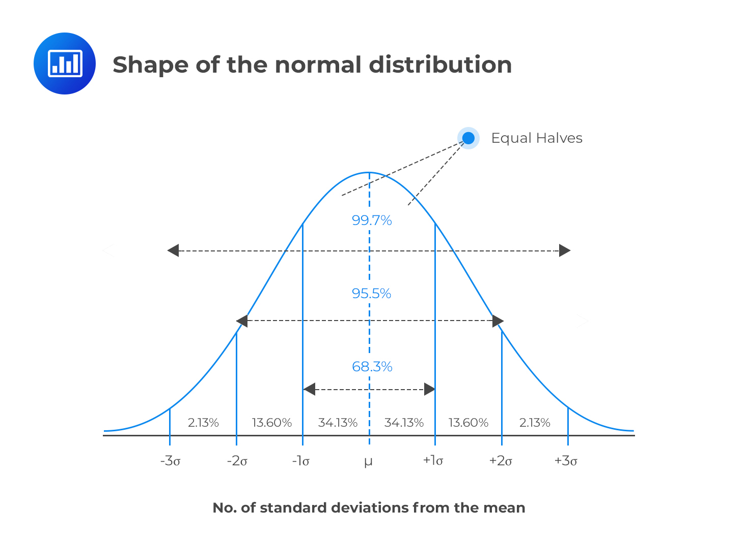
Normal distribution

Slide 5
The Central Limit Theorem (CLT)
What is your understanding of what the central limit theorem (CLT) says?

Slide 6
The Central Limit Theorem (CLT)
Introductory statistics courses talk all about the normal distribution.
Also the t distribution, which is similar.
Not knowing any better, I got the impression that statisticians thought many/most populations were normally distributed.

Slide 7
That’s not why normal is so important
Years later, I learned they don’t think the distribution of the population is necessarily normally distributed.
Or even that this is often the case.
In fact, they often don’t care (much) about how the population is distributed.

Slide 8
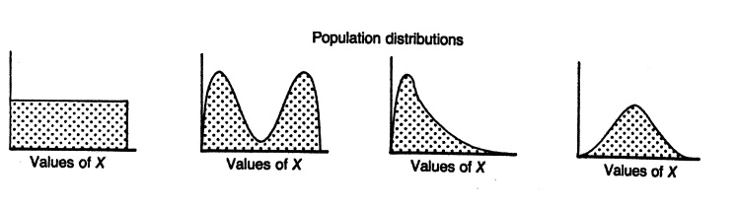
Some (not all) population distributions
Populations can have pretty much any distribution. Here are a few distributions, but populations can be much “funkier”/weirder than any of these.
Very unlikely to actually follow any of these.

Slide 9
What is the power of the field of statistics?
I’d compare it to computer science – programmers can program a computer to do tasks that would take a single person
Statisticians can take an affordably-sized sample and still infer things about a much larger population.
We almost never observe the population.
Might be impossible.
At minimum, would be very costly.

Slide 10
Sampling distribution (of sample means)
What is likely to be approximately normally distributed is the sampling distribution of sample means.
Typically abbreviated as just sampling distribution.

Slide 11
Sampling distribution
So what the heck is the sampling distribution (of sample means)?
It is the distribution of all possible sample means from a given population for a given sample size.
Ok… great, how do we make it?

Slide 12
Sampling distribution
So what the heck is the sampling distribution (of sample means)?
It is the distribution of all possible sample means from a given population for a given sample size.
Ok… great, how do we make it?
We don’t….

Slide 13
Sampling distribution
So what the heck is the sampling distribution (of sample means)?
It is the distribution of all possible sample means from a given population for a given sample size.
Ok… great, how do we make it?
We don’t…. it’s a theoretical distribution that must exist.
Even though we will never actually make it, we know how it exists – this is super powerful!!

Slide 14
Imagine constructing a sampling dist’n
Although people’s heights is not an exciting example, it’s easy for us to imagine the population distribution.
Some tall, some short, lots in between
Might be “funky”, skewed, bi-modal, who knows
It doesn’t actually matter what the population distribution shape is.
Oh how undergrad me would have been surprised!
Imagine you took every sample mean of adults’ heights in Indiana (n=48).
Describe for me some of the most extreme samples (out of billions & billions..)

Slide 15
Most extremes, what about others?
Now that we’ve imagined what the more extreme sample means might look like (and what those samples must have been comprised of), what might some samples in between those look like?
(after) – which sample means are more likely to occur?

Slide 16
Sampling distribution of the sample mean of sample size n
The sampling distribution (of the sample mean of sample size n) represents every single possible sample mean of sample size n that could occur if you were to take all possible samples and shows the probability of each occurring.
Why does sample size matter?
Let’s see

Slide 17
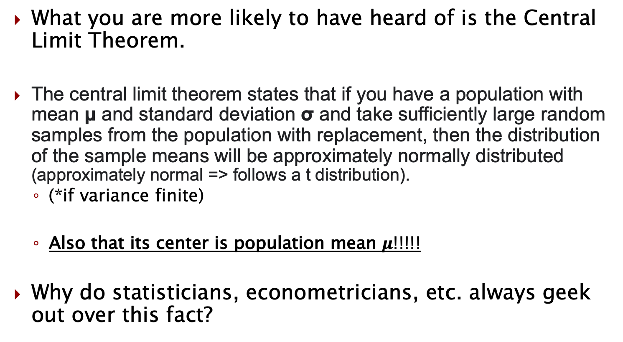
CLT
What you are more likely to have heard of is the Central Limit Theorem.
The central limit theorem states that if you have a population with mean μ and standard deviation σ and take sufficiently large random samples from the population with replacement, then the distribution of the sample means will be approximately normally distributed (approximately normal => follows a t distribution).
(*if variance finite)
Also that its center is population mean $μ$!!!!!
Why do statisticians, econometricians, etc. always geek out over this fact?

Slide 18
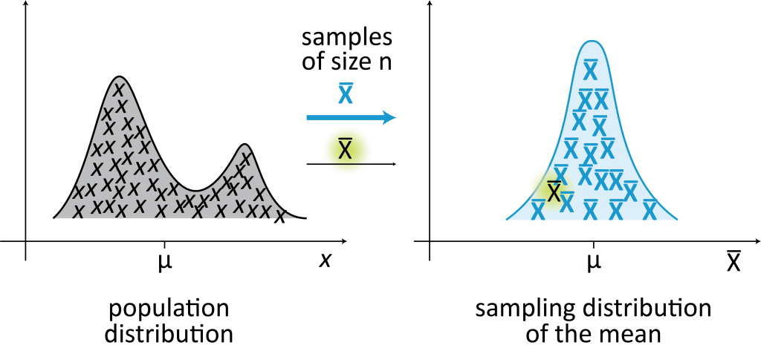
Sampling dist’n vs. pop’n dist’n

Slide 19

But where is our sample mean?
How do we know if our particular sample mean ($\overline{x}$) is at, above, or below the population mean $μ$ ?

Slide 20
Sampling dist’n vs. pop’n dist’n
How do you end up with values at the left tail, right tail,
or near the middle of the sampling distribution?

Slide 21
Sampling ….. of sample size n
Part of the name of the sampling distribution include this “of sample size n”
What happens to the sampling distribution if we increase the sample size?
Instead of n=48, what if we had n=500?
Will it change at all? If so, how?

Slide 22
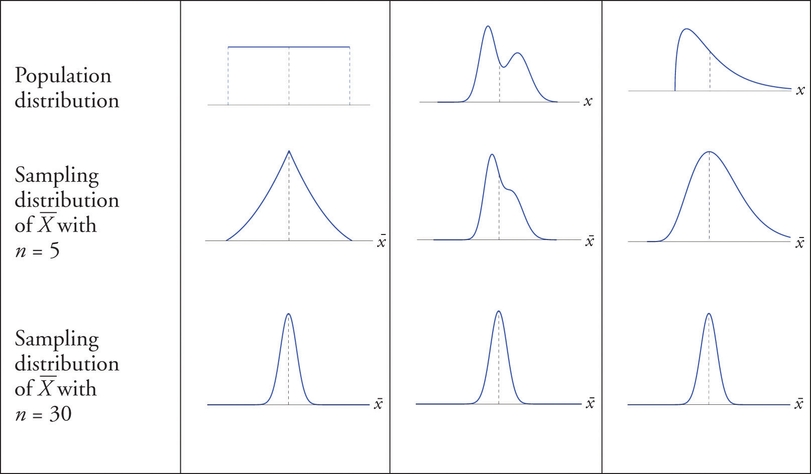
Sampling dist’n & sample size

Slide 23
Population doesn’t matter (much)
Notice in the previous slide that very different population distributions still all generate an approximately normal sampling distribution (w/ a big enough sample size).
But the sampling distribution can be narrower/wider depending on a couple factors.

Slide 24
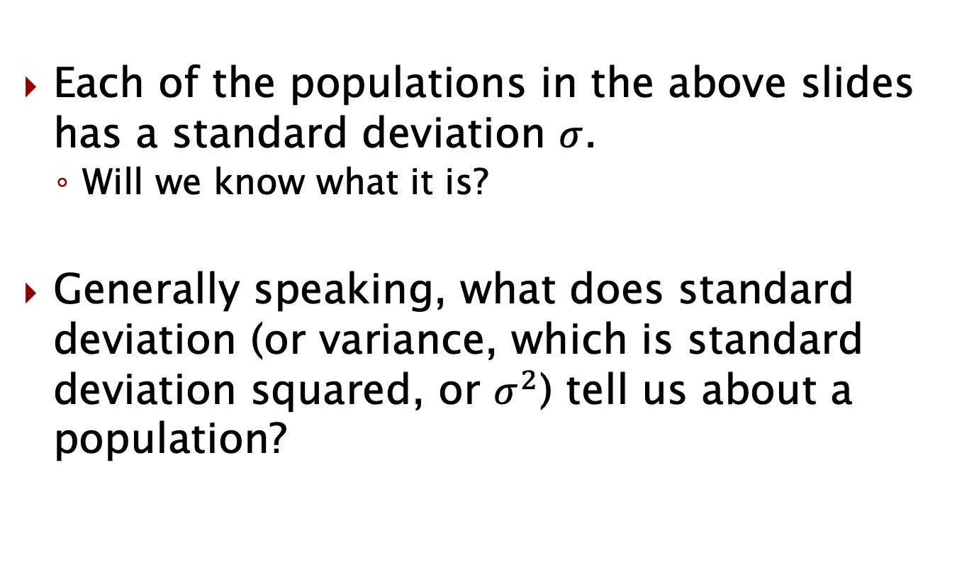
Standard deviation
Each of the populations in the above slides has a standard deviation $σ$.
Will we know what it is?
Generally speaking, what does standard deviation (or variance, which is standard deviation squared, or $σ^{2}$) tell us about a population?

Slide 25
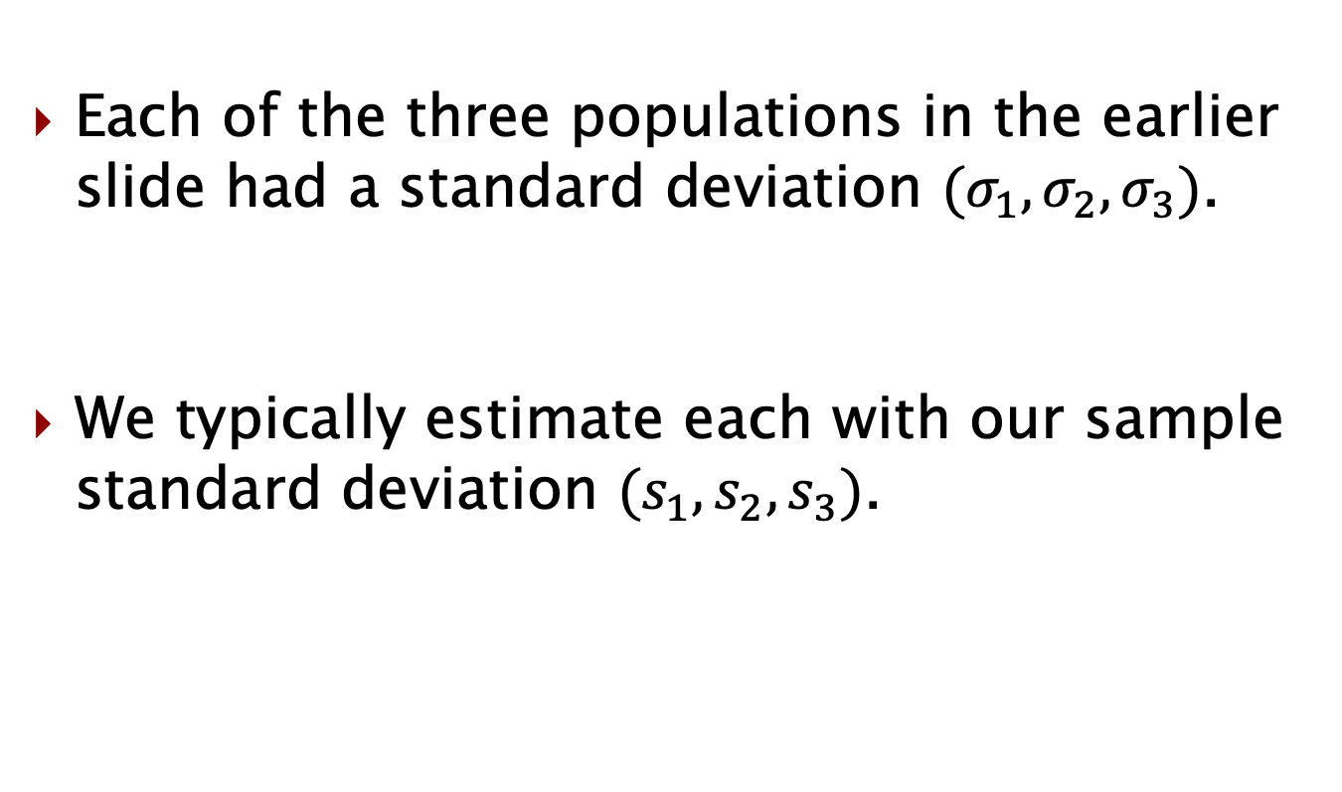
Standard deviation
Each of the three populations in the earlier slide had a standard deviation $(σ_{1},σ_{2},σ_{3})$.
We typically estimate each with our sample standard deviation $(s_{1},s_{2},s_{3})$.

Slide 26
Standard deviation
Does the sampling distribution have a standard deviation? What is it?
Yes, it’s the standard deviation of the sampling dist’n (we just don’t know what it is).
Tells us how spread out the sampling dist’n is.
We can’t know it (without entire sampling dist’n – will we ever have this?), but we can estimate it.

Slide 27
Standard error
(for the same underlying population) The sampling distribution of size 100 is narrower than the sampling distribution of size 50.
Why?
Is the center of the sampling dist’n different?
What must the standard deviation of the sampling distribution be a function of?

Slide 28
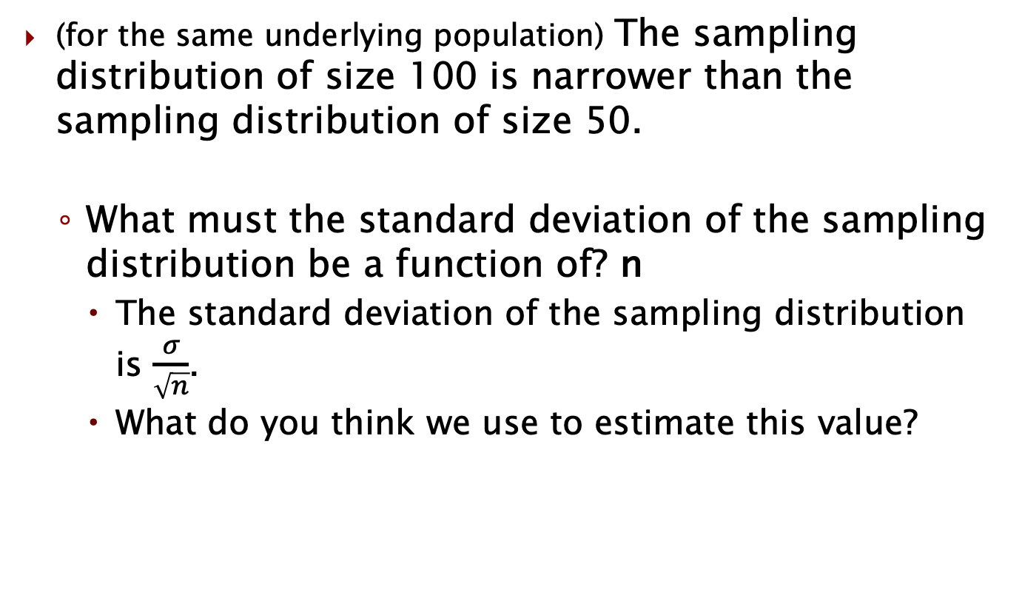
Standard error
(for the same underlying population) The sampling distribution of size 100 is narrower than the sampling distribution of size 50.
What must the standard deviation of the sampling distribution be a function of? n
The standard deviation of the sampling distribution is $\frac{σ}{\sqrt{n}}$.
What do you think we use to estimate this value?

Slide 29
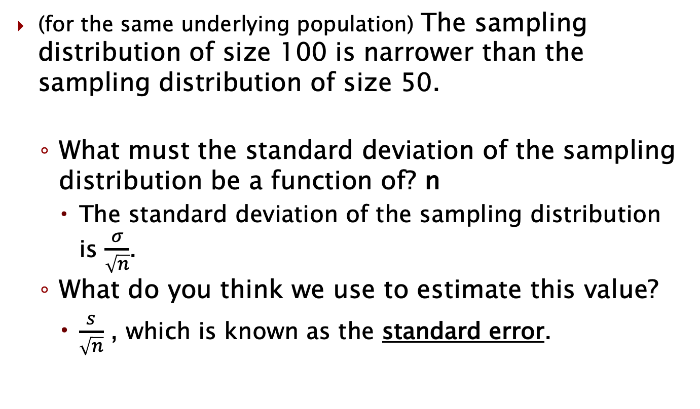
*Standard error
(for the same underlying population) The sampling distribution of size 100 is narrower than the sampling distribution of size 50.
What must the standard deviation of the sampling distribution be a function of? n
The standard deviation of the sampling distribution is $\frac{σ}{\sqrt{n}}$.
What do you think we use to estimate this value?
$\frac{s}{\sqrt{n}}$ , which is known as the standard error.

Slide 30
Why do we care about standard errors?
To summarize, a standard error estimates a standard deviation of the sampling distribution.
Estimates how “spread out” sampling dist is.
Gives us a measuring stick so we can tell when something is “really far” away or not.

Slide 31
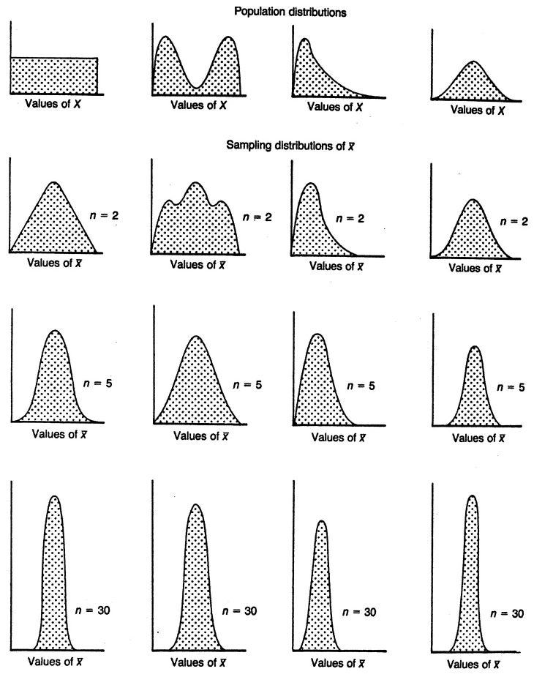
Sampling dist’n & sample size

Slide 32
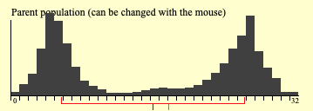
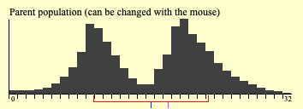
Two different populations
Typically, we can’t observe an entire pop’n (this is why statisticians are so valuable).
Let’s imagine we can for a moment.
Which will be larger for the two populations?
Standard deviation of sampling distribution of n=30 for population 1
Standard deviation of sampling distribution of n=30 for population 2
What will each sampling distribution look like?
Notes:
https://onlinestatbook.com/stat_sim/sampling_dist/index.html

Slide 33
Let’s look at some regression outpout
Let’s jump back to Class 1.1 data and run that basic regression on the shoe sales data so we can see if we understand more of it now.
What is the standard error value on price?
How many standard errors away from zero is our estimated effect?
If zero was the true effect, how likely would it be to observe a sample effect this far away? (very? Not very?)

Slide 34
HR Training example
Suppose a medical firm has software that their employees regularly use.
They have a new training method they want to try out, but since they’re unsure of its efficacy, they only do it with 1/3 of the employees who use it.
Six months later, they want to know if it was effective.
A note for later in the semester: this firm is interested in knowing the causal impact of the software on output. We will later discuss what needs to be true to get a good estimate of this.

Slide 35
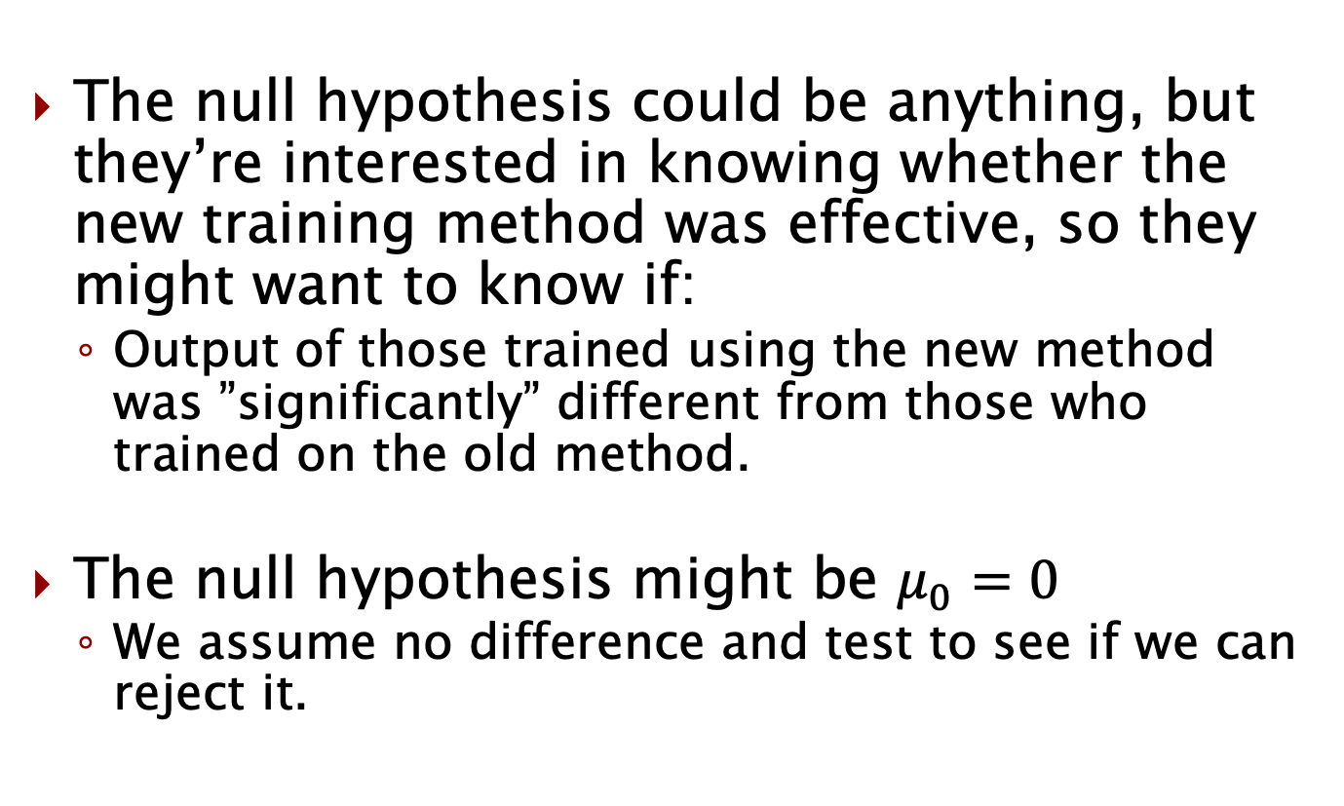
What’s our null hypothesis here?
The null hypothesis could be anything, but they’re interested in knowing whether the new training method was effective, so they might want to know if:
Output of those trained using the new method was ”significantly” different from those who trained on the old method.
The null hypothesis might be $μ_{0}=0$
We assume no difference and test to see if we can reject it.

Slide 36
How do we tell?
Suppose they measure the average output of each group and get a value of 0.24 units higher for those trained in the new method.
What could be reasons the new group had higher average output?
How can we use statistics to inform us whether this is “a lot”?

Slide 37
Hypothesis test
A hypothesis test simply looks to see how many standard errors above or below the null hypothesis the observed sample (mean) value is.
Beforehand, we set:
Threshold for how many standard errors away (1.96, 2.0, etc.)
OR
Threshold for p-value (0.05, 0.1, etc.)

Slide 38
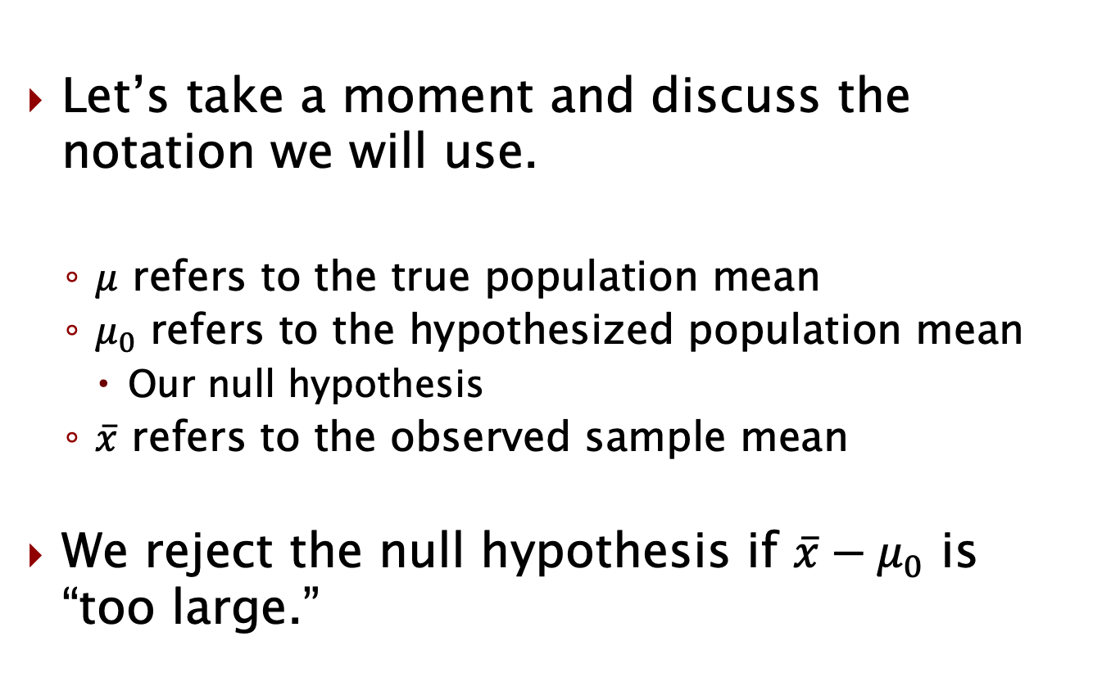
Notation
Let’s take a moment and discuss the notation we will use.
$μ$ refers to the true population mean
$μ_{0}$ refers to the hypothesized population mean
Our null hypothesis
$\overline{x}$ refers to the observed sample mean
We reject the null hypothesis if $\overline{x}−μ_{0}$ is “too large.”

Slide 39
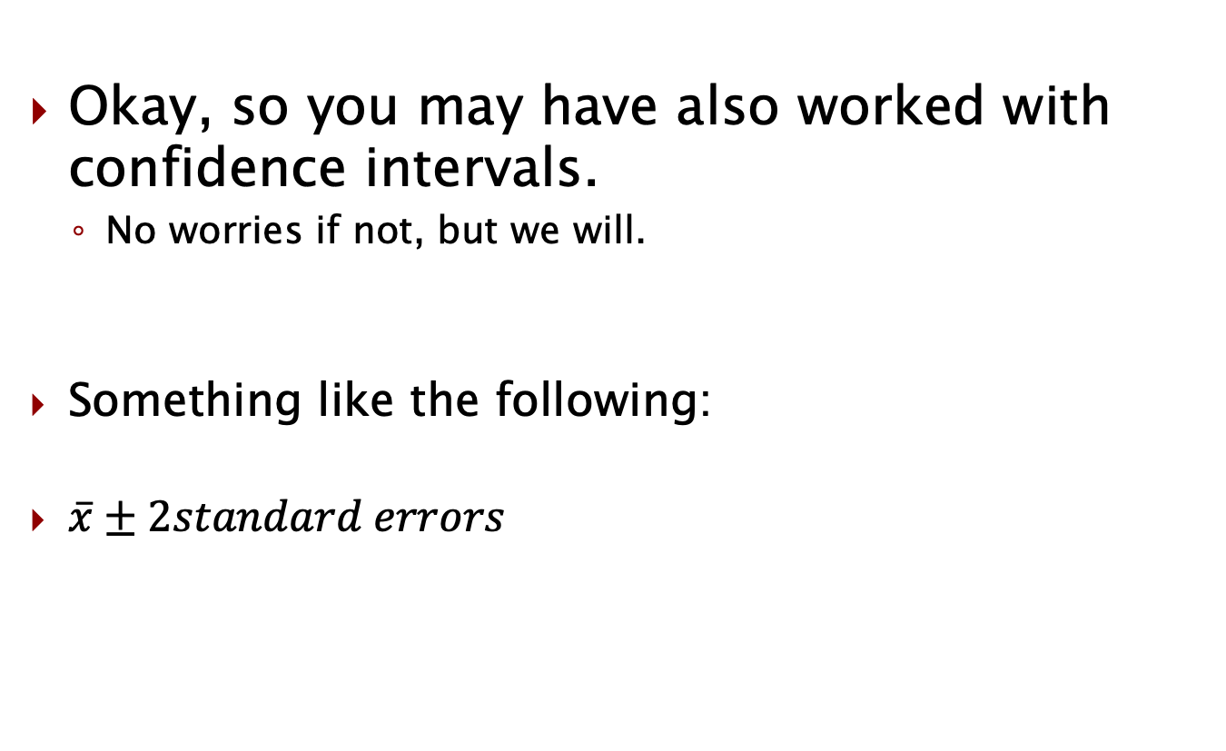
On to confidence intervals
Okay, so you may have also worked with confidence intervals.
No worries if not, but we will.
Something like the following:
$\overline{x}±2standard errors$

Slide 40
Confidence interval example
Let’s say we had a confidence interval for the single population problem.
The 95% confidence interval for the output of the employees using the old method for software training is: (12.64, 18.72)
How would you translate into English what those numbers mean? (use in a sentence)

Slide 41
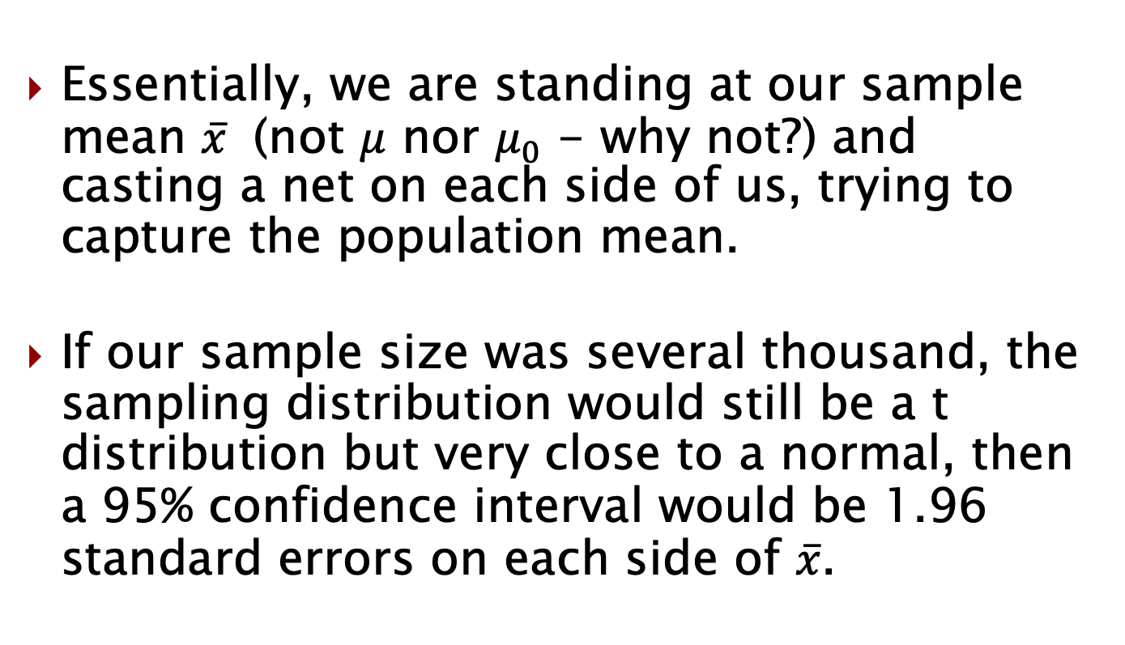
Confidence intervals
Essentially, we are standing at our sample mean $\overline{x}$ (not $μ$ nor $μ_{0}$ - why not?) and casting a net on each side of us, trying to capture the population mean.
If our sample size was several thousand, the sampling distribution would still be a t distribution but very close to a normal, then a 95% confidence interval would be 1.96 standard errors on each side of $\overline{x}$.

Slide 42
Confidence intervals
Ok, great…
But how do we know that 95% of the time the true population mean will be inside the confidence interval?

Slide 43
Confidence interval as “nets”
*We’ll actually estimate using standard errors not standard deviations

Slide 44
What did we learn?
What does each of the following tell us?
standard error
t statistic
p value

Slide 45
P value
What is each of the following?
standard error
Estimate of the standard deviation of the sampling distribution
t statistic
The number of standard errors an observation is away from the null hypothesis
p value
The probability that, if the null hypothesis had been true, that we would have observed something as extreme as we observed or something even more extreme.

Slide 46
Announcements
Don’t forget to join a team if you want
People -> Problem Set Groups

